Slide 1





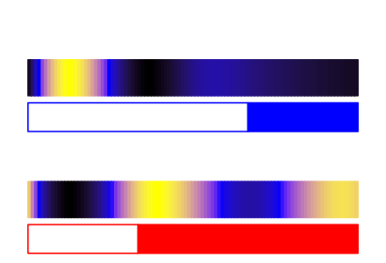


















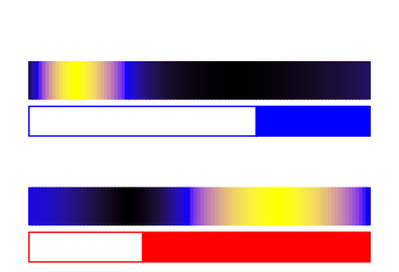


























Pyruvate
Protein LD
low
high
(A)
GAP
Transcript LD
Protein SD
DXS
Transcript SD
Neoxanthin
DPX
Uriolide
NXS
DXR
MEP
Violaxanthin
CMS
Micromonal
VDE
ZEP
CDP-ME
CMK
CDP-MEP
Dihydrolutein
Prasinoxanthin
Antheraxanthin
MCS
VDE
ZEP
MEcPP
HDS
HMB-PP
Lutein
Zeaxanthin
HDR
εCH
βCH
IPP
DMAPP
βCH
GPPS
GPPS
α-carotene
β-carotene
GPP
LCYε/β
GGPPS
GGPP
PSY
Phytoene
PDS
ζ-carotene
ZDS
Lycopene
(B)
Transcript LD
Transcript SD
Protein LD
Protein SD
(C)
DXS - ostta02g01730
α-carotene
DXR - ostta04g03270
dihydrolutein
CMS - ostta07g03570
α branch
lutein
MEP
Pathway
CMK - ostta16g01910
prasinoxanthin
MCS - ostta11g00050
micromonal
HDS - ostta09g00960
uriolide
HDS - ostta09g00960
β-carotene
HDR - ostta08g01180
GPPS - ostta04g03170
β branch
zeaxanthin
GGPPS - ostta12g01280
antheraxanthin
PSY - ostta05g03530
violaxanthin
PDS - ostta10g02860
neoxanthin
Carotenogenesis Pathway
ZDS - ostta16g00590
LCYε/β - ostta14g00700
βCH - ostta13g02440
ZEP - ostta16g00670
VDE - ostta16g00660
NXS - ostta03g05610
εCH - ostta09g02540
α branch

